Slide 1

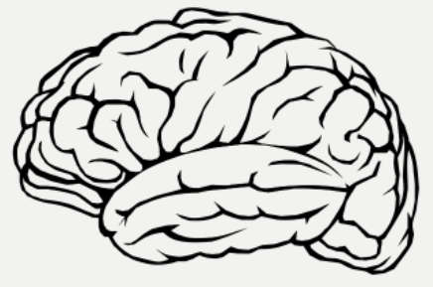
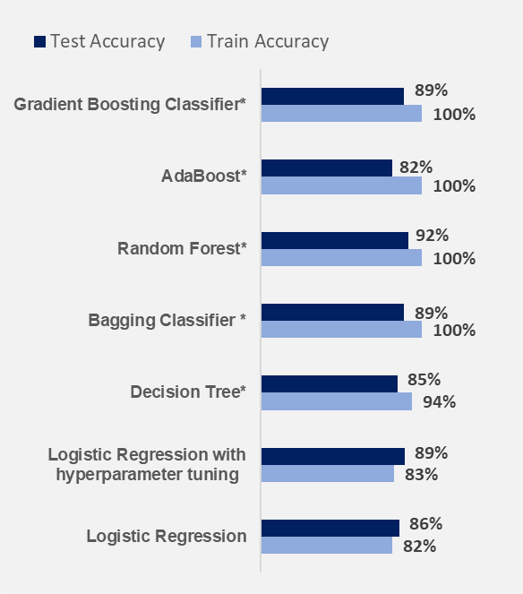
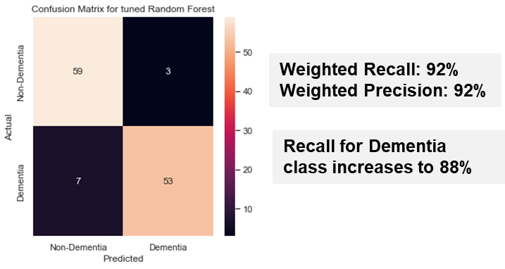
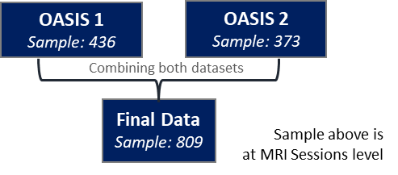
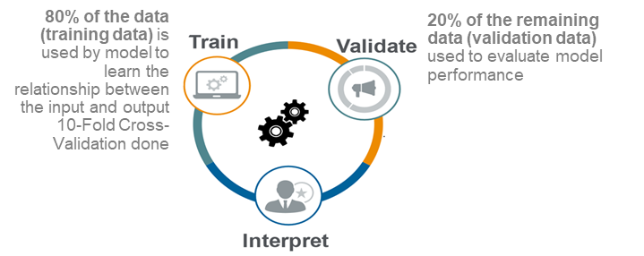
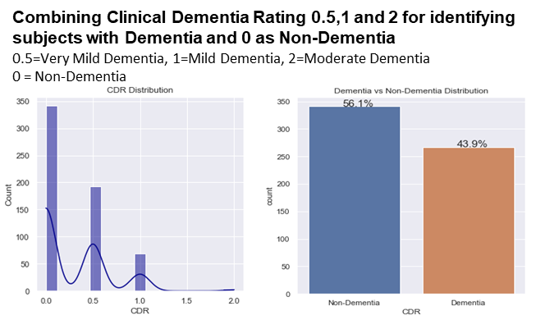

Predicting the Risk of Alzheimer’s Disease Siddharth Mahapatra, Priyanshu Tanwar, Pooja Srivastava, Amit Gupta
Motivation & Problem Statement
ML Model Design
Results
Alzheimer's disease is a progressive brain disorder that slowly destroys memory and thinking skills. In 2020, there were ~ 50M people worldwide with Alzheimer's disease affecting 6% of people 65 years and above. Challenges in early Diagnosis:
Expensive examinations
Patients aren’t tested until they show cognitive decline: by then, its too late.
Objective: Early Detection of Alzheimer’s Disease using Machine Learning algorithms which would help lot of patients predetermine the condition they may face in future & prevent the disease
1
Feature Engineering :
Missing Value Treatment :
Removed 201 entries where Clinical Dementia Rating(CDR) is missing. Rationale: Imputation not done as CDR is the dependent variable.
Mean Imputation done for Socio Economic Status (SES) & Mini Mental State Examination.
Removing Features:
Handedness and Delay as features removed.
Best Forest
Model Results
Final Sample Size after missing value treatment : 608
Data & Labels
2
ML Models & Interpretability
OASIS 1 & 2 dataset used from Open Access Series of Imaging Studies:
OASIS 1: Cross-sectional MRI Data in Young, Middle Aged, Nondemented and Demented Older Adults (436 samples)
OASIS 2: Longitudinal MRI Data in Nondemented and Demented Older Adults.(373 samples)
6 Machine Learning Models tested; Random Forest finally chosen based on best Test Accuracy
Logistic Regression - Base Model
Decision Tree
Bagging Classifier
Random Forest – Best Model
Adaboost Gradient
Boosting Classifier
Source: Open Access Series of Imaging Studies
Base Model
Each Model optimized for hyperparameters
Confusion Matrix-
Best Model (Random Forest)
Results
Explainer interactive Dashboard created which enables:
quickly inspect the workings and performance of the final model
Overall Feature Importance using SHAP values & SHAP Dependence plots
Explains individual predictions of final model (SHAP values)
Further Data Augmentation
Research the difference b/w Catboost vs LightGBM vs Adaboost
Experiment Catboost and LightGBM and compare results with Adaboost

